Slide 1
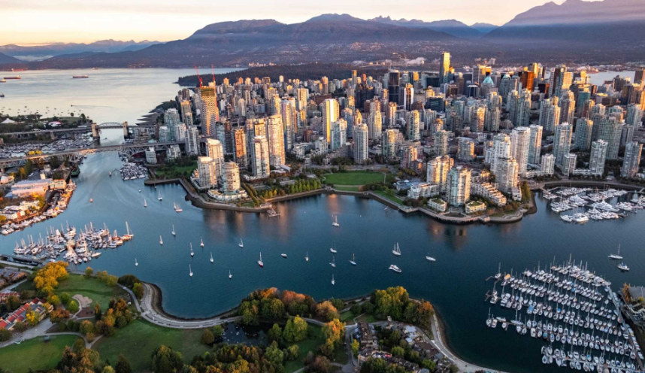
Opening up a successful restaurant in Vancouver

Slide 2
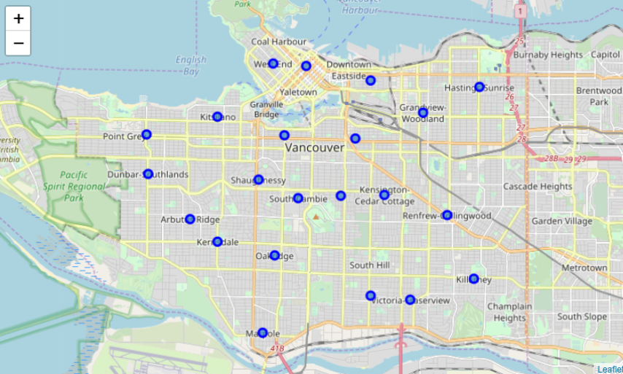
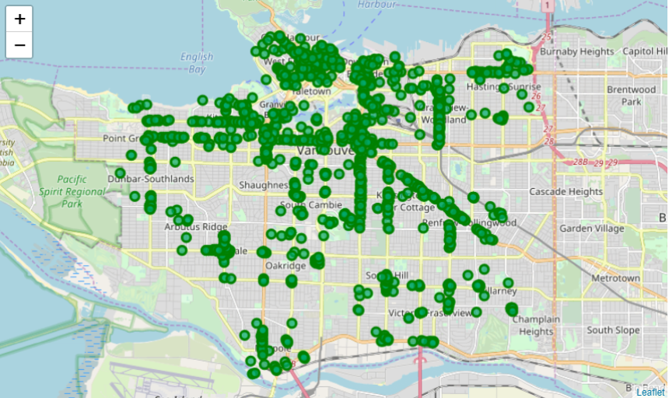
Data
Vancouver Venues
Vancouver Neighbourhoods

Slide 3
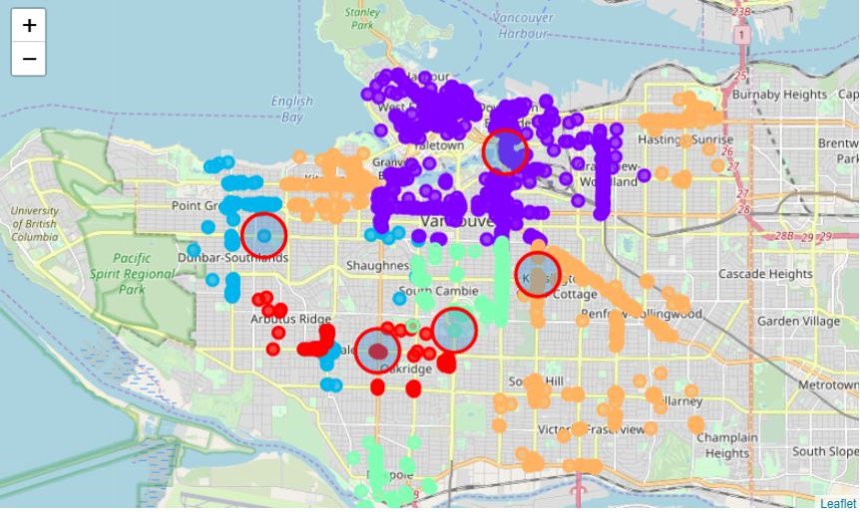
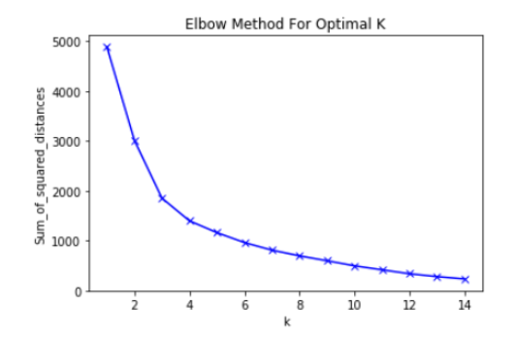
Methodology
Kmeans
Elbow Method (K = 5)

Slide 4
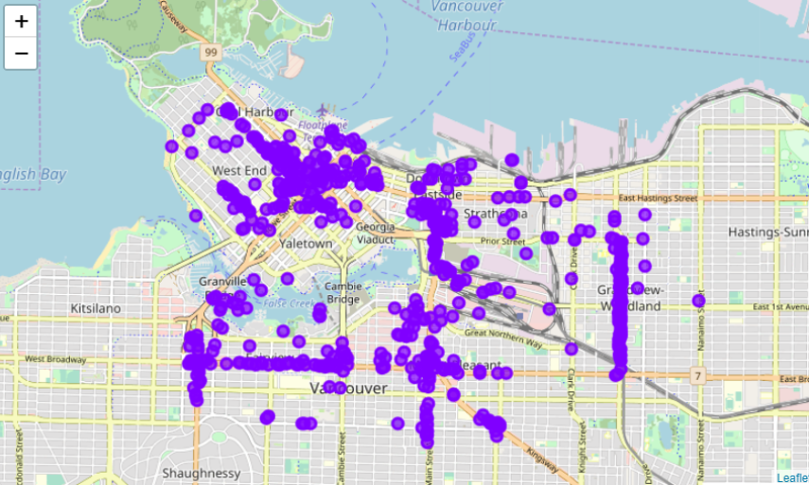
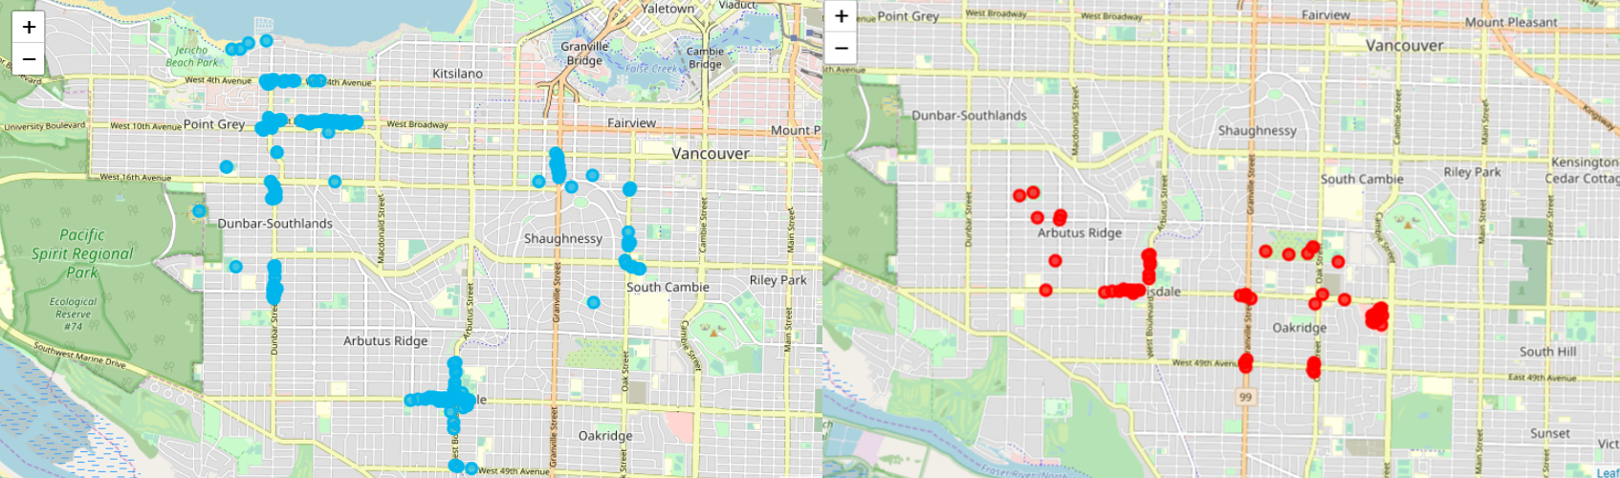
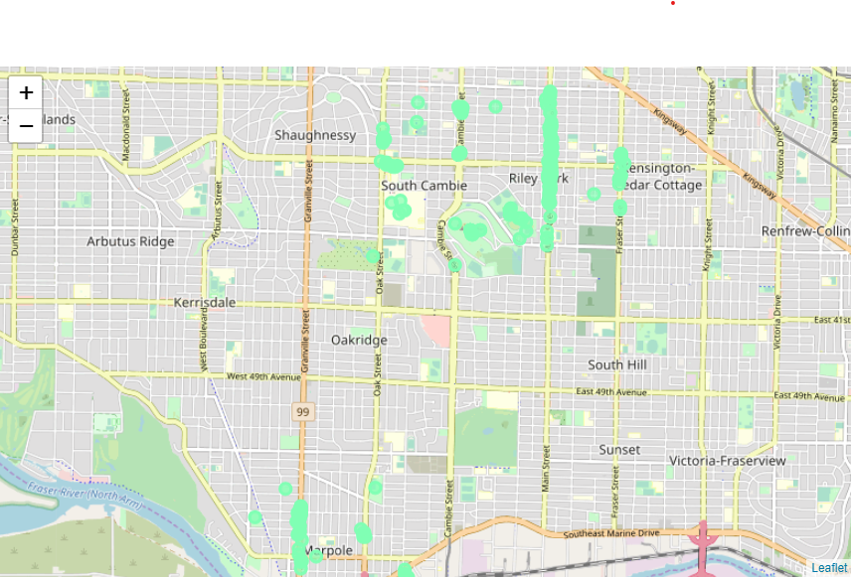
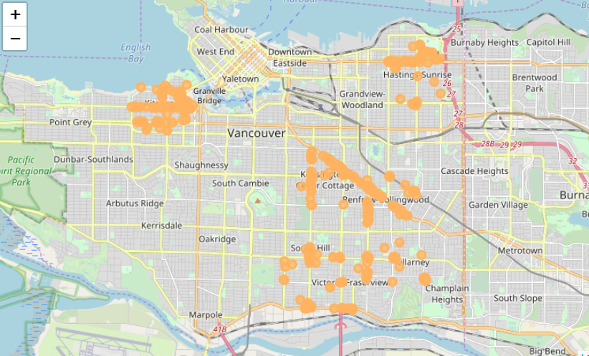
Discussion

Slide 5

Results
Cluster 0 (Downtown Vancouver) : Japanese Restaurant
Cluster 1 (West Point Grey) : Sushi Restaurant
Cluster 2 (Marpole) : Chinese Restaurant
Cluster 3 (Kitsilano) : Vietnamese Restaurant
Cluster 4 (Oakridge) : Sushi Restaurant

